Slide 1
Science Understanding
Homeostasis
Gas

Slide 2

Study Guide
Read:
Our Human Species (7th ed)
Chapter 8
Complete:
Human Biological Science Workbook
Topic 6 – Regulation of Gas Concentration

Slide 3

Further information
Write down the chapter and page numbers in HP that cover this topic:
Ch: __________________
Pages: _______________

Slide 4
Unit 3 – Homeostasis
gas concentrations are controlled by balancing the intake of oxygen and the removal of carbon dioxide via the lungs, through the actions of the medulla oblongata and the autonomic nervous system

Slide 5
Control of breathing
Breathing can be voluntary or involuntary.
Control centres occur in the brain stem:
  Medullary rhythmicity centre (normal breathing)
  Apneustic centre (pons) - rate of breathing
  Pneumotaxic centre (pons) – depth of breathing
Nerve impulses activate respiratory muscles:
  Diaphragm
  Intercostal muscles (internal & external)

Slide 6
Normal breathing patterns
Respiratory cycle
Quiet breathing
Inhalation – active
Exhalation - passive
Forced breathing
Inhalation & exhalation active
Diaphragmatic
(deep) breathing
Costal
(shallow) breathing

Slide 7
Regulation of the normal breathing cycle
Quiet breathing
Inspiration
  Inspiratory nucleus activated
  Nerve impulses sent to respiratory muscles
  Respiratory muscles contract
  (2 seconds)
Expiration
  Inspiratory nucleus suppressed
  Respiratory muscles relax
  (3 seconds)

Slide 8
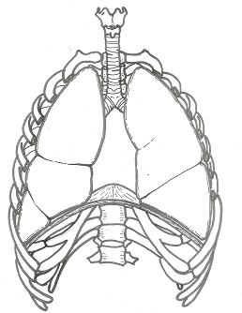
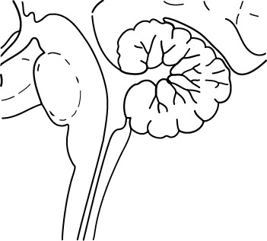
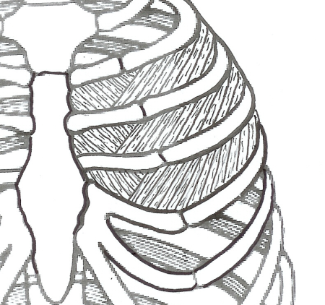
Control of normal breathing
Impulse to diaphragm & external intercostal muscles
INHALE
+
-
Inspiratory nucleus
Exspiratory nucleus
EXHALE
Medullary rhythmicity centre
Impulse to internal intercostal muscles

Slide 9
Regulation of forced breathing
Forced breathing
Inspiration
  Inspiratory nucleus activated/ expiratory nucleus suppressed
  Nerve impulses sent to respiratory muscles
  Inspiratory muscles contract/expiratory muscles relax
Expiration
  Expiratory nucleus activated/Inspiratory nucleus suppressed
  Nerve impulses sent to respiratory muscles
  Expiratory muscles contract/Inspiratory muscles relax

Slide 10
Respiratory reflexes
Normal breathing is modified by:
Changes in levels of oxygen & carbon dioxide
Changes in blood pressure
Stretch receptors in lungs
Irritants (sneezing, coughing etc.)
Sensations such as cold or pain

Slide 11
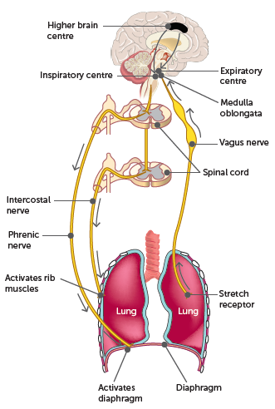
6.2 Regulation of gas concentrations
Control of breathing by respiratory centres in the brain

Slide 12
6.2 Regulation of gas concentrations
Chemicals affecting breathing
Oxygen, carbon dioxide and hydrogen ions all have some effect on the regulation of breathing activity.
Chemoreceptors
There are two types of chemoreceptors:
Peripheral chemoreceptors – in the walls of the aorta and carotid arteries - known as the aortic and carotid bodies. Sensitive to changes in blood plasma
Central chemoreceptors are located in the medulla oblongata. These are sensitive to changes in the cerebrospinal fluid.

Slide 13
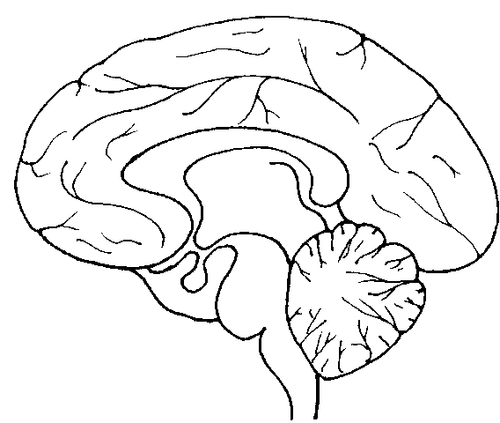
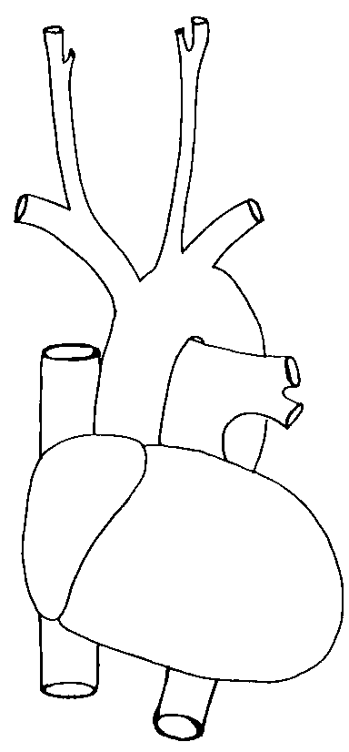
Respiratory reflexes
Sensory input from conscious area of the brain
Sensory input from other parts of the body
Sensory input from other parts of the body
Carbon dioxide and oxygen receptors
Respiratory centre
Nerve impulses to respiratory muscles

Slide 14
Respiratory chemistry
normal pH range of blood is around 7.35.
Increasing levels of CO₂ from decreased respiration rate increases the amount of carbonic acid
This decreases blood pH
Decreasing levels of CO₂ from increased respiration rate decreases the amount of carbonic acid
This increases blood pH
NB: Under normal circumstances, oxygen plays little part in the regulation of breathing.

Slide 15
Effect of high CO₂/low O₂ on breathing
Stimulus - High CO₂ (= low pH or high H⁺) or low O₂
Receptor – Chemoreceptors
  Aorta - High CO₂ or low O₂
  Carotid artery – High CO₂ or low O₂
  Medulla oblongata - High CO₂ only Note – this takes longer to respond, several minutes
Control centre - Respiratory centres in brain stem
Transmission - Reflexes involving somatic nerves
Effector - Respiratory muscles
Response - Increased rate and depth of breathing

Slide 16
Negative feedback loop
Chemoreceptors
  Aorta
  Carotid artery
  Medulla oblongata
High CO2
(= low pH or high H+)
or low O2
Stimulus
Receptor
Respiratory centres in brain stem
Levels of CO2
& O2 return to normal
Control
centre
Feedback
Reflexes involving somatic nerves
Response
Effector
Increased rate and depth of breathing
Respiratory muscles

Slide 17
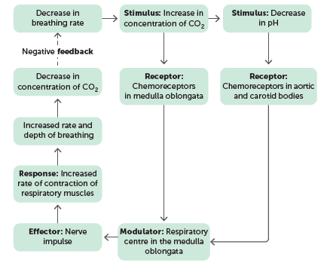
6.2 Regulation of gas concentrations
Hydrogen ion concentration
As the hydrogen ion concentration of the blood increases, the pH decreases. A decrease in the pH directly stimulates chemoreceptors in the aortic and carotid bodies, which then transmit impulses to the respiratory centre, resulting in an increase in the breathing rate and depth.
Negative feedback control of breathing rate through changes in the concentration of carbon dioxide and the pH of the blood plasma

Slide 18
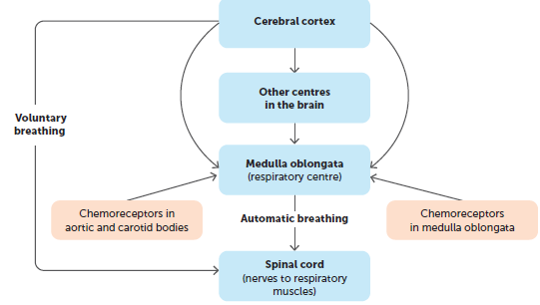
6.2 Regulation of gas concentrations
Voluntary control of breathing
Voluntary control bypasses the respiratory centre in the medulla oblongata.
Protective – allows us to avoid pollutants etc.
Holding our breath
We can hold our breath for a short time. The build-up of carbon dioxide in the plasma stimulates the inspiratory centre to send impulses to the inspiratory muscles. Therefore, we are eventually forced to take a breath.
Voluntary and involuntary control of breathing by the CNS

Slide 19
Study Questions
What is the common name for ventilation?
Why do we need constant air flow through the lungs?
How does the respiratory system interact with the circulatory and nervous system?
Describe in detail the control of normal breathing. (10 mark question)
Explain the difference between active and passive breathing
What can cause a rise pH in the blood?

Slide 20
Study Questions
Why is pH monitored rather than CO₂ levels?
How do CO₂ levels effect H⁺ and pH?
How does the respiratory centre respond to a drop in pH?
Detail the evidence that suggests an increase in breathing rate during exercise does not result from an increase in CO₂ in the blood. What does cause the change in breathing rate?
Name and describe the role and location receptors in breathing

Slide 21
Study Questions
Explain hyperventilation, and explain why swimmers hyperventilate
What effect does hyperventilation have on CO₂ and O₂ concentration in the blood?
What happens when we lose consciousness under water?
Explain why people do not feel the need to breathe before losing conciousness in this situation?
Describe the effect of adrenaline on breathing
List other factors that affect breathing

